Slide 1

Classify social class by Real Estate
ABDULAZIZ

Slide 2
Back Story

Slide 3
Process
Scrapping
EDA
Modeling
Prediction

Slide 4
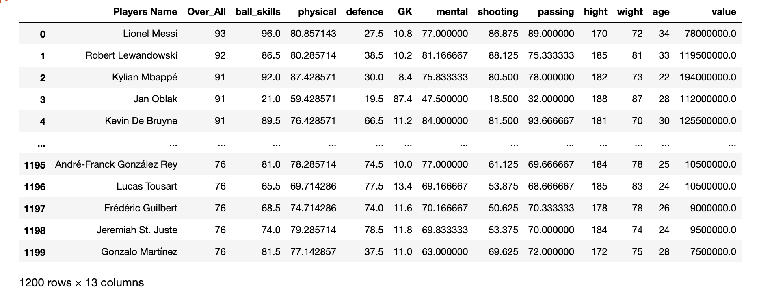
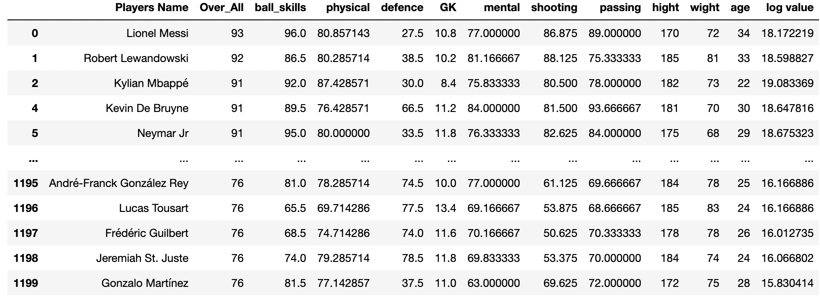
OUR PLAYERS DATASET

Slide 5
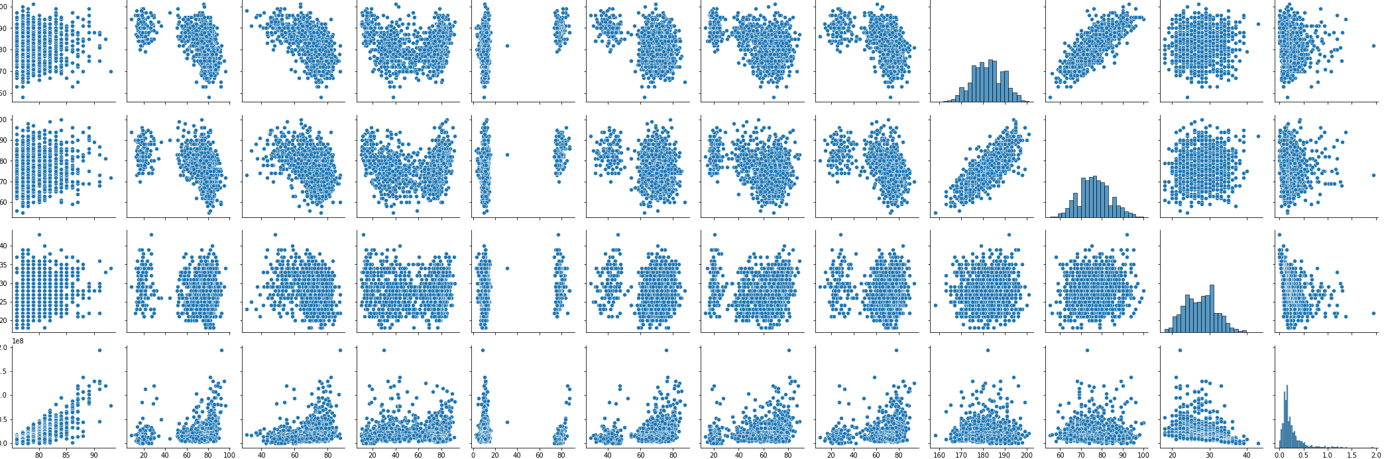
Correlation plot

Slide 6
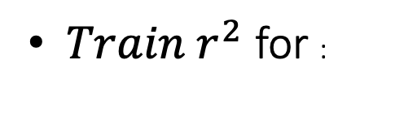
Model Selection
Linear Regression is : 0.491
Polynomial Regression:0.753
Lasso Regression:0.768
Ridge Regression:0. 749
Elastic Regression:0. 512
$Train r^{2}$ for :

Slide 7
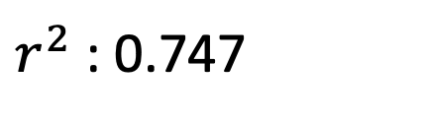
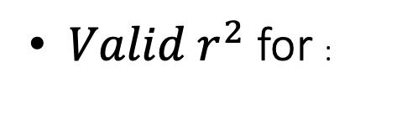
Model Selection (Cont)
Polynomial Regression:0.674
Lasso Regression:0.686
Ridge Regression:0.674
Elastic Regression:0.405
$Valid r^{2}$ for :
Scoring on Test Set for Linear Regression:
$r^{2}$ : 0.747

Slide 8
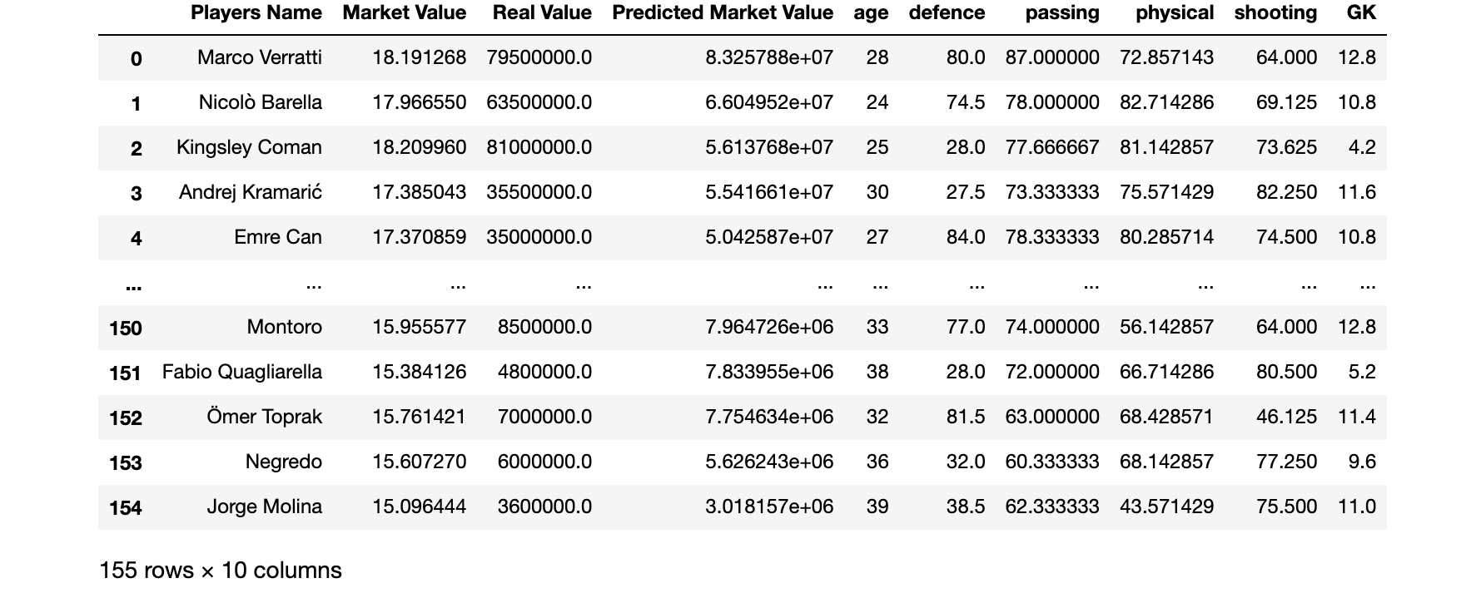
Our Prediction

Slide 9
Conclusion
The prices didn’t get higher as we expected
Polynomial Regression can be a helpful in our case.
Market Value could be dependent on other important features.

Slide 10

Thank You

